Slide 1
Capstone project Payment fraud detection system
General Assembly – Data science
Sébastien Wallukat

Slide 2
Question
Can we automate the decision making for a payment fraud detection system using machine learning?

Slide 3
Context
From 2011 to 2020, on credit card only, the amount of fraud rose from US$ 9.84 billion to US$ 32.39 billion
High volume of transactions (188 B in 2020 for Visa only) that request real time responses
Due to the nature of the information, there is no public database from CC/payments companies
The project will use a generator from fraud detection handbook by Yann-Aël Le Borgne and Gianluca Bontempi

Slide 4
Data
3 Datasets generated
5000 unique customers
1000 unique terminals
180 days of transactions history
1 754 155 transactions in total
16 029 Fraudulent transaction (0,91% of the total transaction count)
Fraud scenario
Scenario 1: Any transaction whose amount is more than 220 is a fraud
Scenario 2: Every day, a list of 6 terminals is drawn at random. All transactions on these terminals in the next 28 days will be marked as fraudulent.
Scenario 3: Every day, a list of 6 customers is drawn at random. In the next 14 days, 1/3 of their transactions have their amounts multiplied by 5 and marked as fraudulent.
Scenario 4 : Every day a list of 4 customers is drawn at random. In the next 3 days every transaction have their amount multiplied by a random number between 3 and 6.

Slide 5
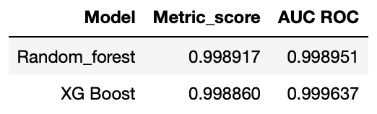
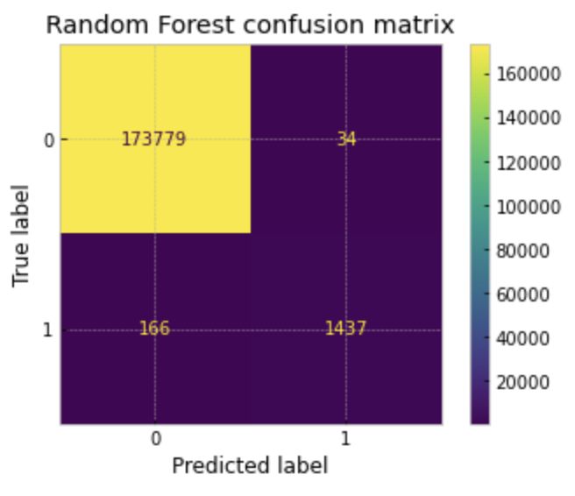
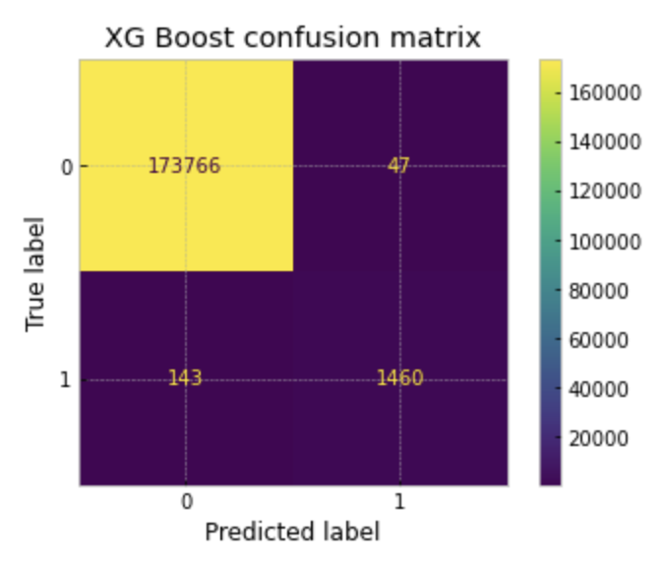
Model results

Slide 6
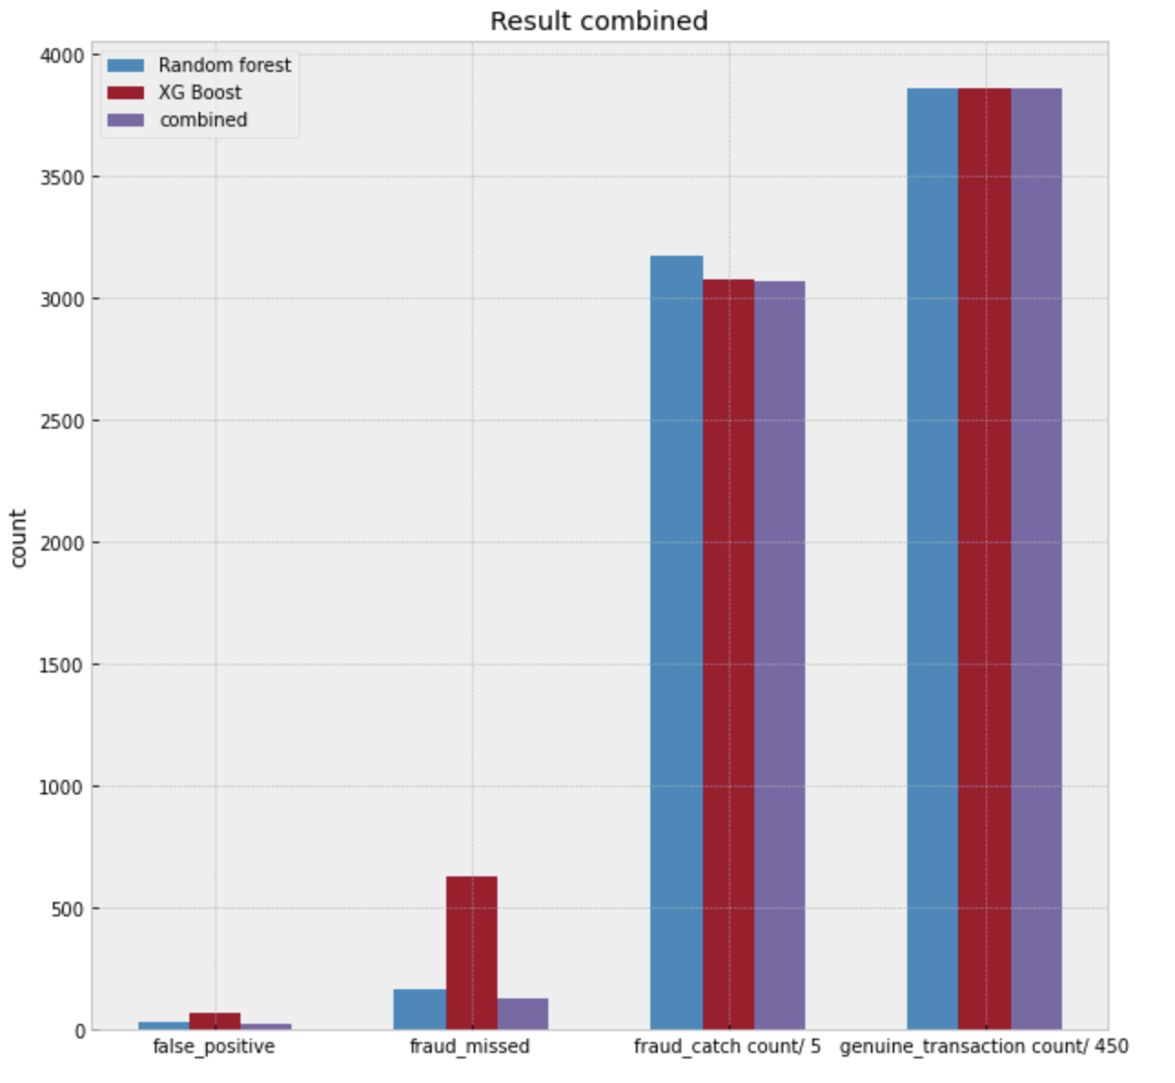
Decision optimization
Setting
If both models are giving the same result the transaction is directly allowed or denied
If their decision are not identical the transaction go to manual review
Transactions reviewed
504 transactions in total
532 genuine transactions
62 fraudulent transactions

Slide 7
Result
Fraud count per 1 000 tx | Fraud catch per 1 000 tx | False positive per 1 000 tx | Fraud missed per 1 000 tx | Tx review per 1 000 tx
9.138 | 8.759 | 0.013 | 0.076 | 0.047
Accuracy
Using both models, we can reach an accuracy score of 0.999573013787265
Result per 1 000 transactions

Slide 8

Usage
Real time detection
Strength
Able to deal with huge volume of transactions with a limited number of human interactions
Efficient on global risk mitigation
Limit
Timeframe needed to take the decision
Each model need to be trained regularly
Global review
Strength
Allow to detect potential trend or weak point
Limit
No direct impact on real time decision
Can’t identify a specific fraud trend at this stage

Slide 9
Next step
Dynamic fraud pattern detection
Product related scoring
ML engine for detecting link between different customers

Slide 10

Thanks for listening

